Slide 1



Water Level Monitoring System in Dams using IOT
GLOBAL ACADEMY OF TECHNOLOGY
Department of Information Science & Engineering
Mini Project Presentation
Guided By:
Prof. Poornima R M
Presented By:
Devamma - 1GA22IS046
Kruthika U Shankar - 1GA22IS084
Kumudha Shree H - 1GA22IS085
Notes:
We designed this template so that each member of the project team has a set of slides with its own theme where he/she can present their research. Members, here’s how you add a new slide to just your set:
Mark where you want to add the slide: Select an existing one in the Thumbnails pane, click the New Slide button, then choose a layout.
The new slide gets the same theme as the previous one you selected.
Careful! Don’t annoy your fellow presenters by accidentally changing their themes. That can happen if you choose a theme Variant from the Design tab, which changes all of the slides in your presentation to that look.

Slide 2
Agenda
Overview / Background
Problem Statement
Motivation
Objectives
Literature Review
Project Requirements
System Architecture
Expected Outcome

Slide 3
Overview
The project monitors water levels in dams to prevent overflows.
It provides an early warning when the water level is too high.
A buzzer gives sound alerts based on the water level.
A yellow light indicates when the water level reaches a critical point.
A website is included for easy tracking and management of water level data.
The system helps enhance safety and reduce the need for manual checks.

Slide 4
Motivation
Sustainable Water Resource Management
Infrastructure Safety
Operational Efficiency
Environmental Protection
Technological Innovation
Socio-Economic Impact
Ø
Ø

Slide 5
Objectives
Efficient water management and improved dam safety.
Real-time monitoring with automation and control.
Environmental protection and disaster preparedness.
Scalability, adaptability and cost-effectiveness.

Slide 6
Literature Review

Slide 7
Literature Review
Author | Title | Journal | Year | Approach | Key Findings
Sai sreekar siddula, Phaneendra babu P.c jain | Water level monitoring and management of dams | IEEE | 2024 | Iot Monitoring Dam Management | Real-Time Monitoring Efficient control
1 Anitha Gopalan, 2 M. Saranya Nair, 3T Hema Latha | A Sensitive Design of Dam Water Level Monitoring and Emergency Alert Handling System using Internet of Things | 2024 Ninth International Conference on Science Technology Engineering and Mathematics (ICONSTEM) | 2024 | Threshold Detection Automated Alerts | Enhanced Safety Rapid Response
Phaneendra babu P.c jain Sanober Shama bano | Smart water level monitoring system using internet of things (iot) | Global conference on wireless and optical technologies (GCWOT) And IEEE | 2023 | Iot Monitoring Dam Management | Real-Time Monitoring Efficient Control

Slide 8
Author | Title | Journal | Year | Approach | Key Findings
Senthil Ganesh | An IOT -based Dam Water Level Monitoring and Alerting System | IEEE Xplore Part Number: CFP22BC3-ART | 2023 | Automation, automated alerts | Real-time alerts , reduced wastage of water, Cost effective
D. Dhinakaran1 , S. M. Udhaya Sankar2 , B. Charu Latha3 , A. Erlin Joy Anns4, V. Keerthana Sri5 | Dam Management and Disaster Monitoring System using IoT | 2023 International Conference on Sustainable Computing and Data Communication Systems (ICSCDS) | 2023 | Sensor Deployment Data Analytics | Risk Mitigation Real-Time Alerts

Slide 9
Problem Statement

Slide 10
Problem Statement
The lack of an integrated water monitoring system limits dam safety, resource management, and emergency response. Real-time data and automation are essential for addressing risks, ensuring efficiency, and supporting informed decision-making.

Slide 11
Project Requirements

Slide 12
Hardware Requirements Identified
Arduino Nano
LED (Yellow)
Buzzer
Ultrasonic Sensor
Connecting Wires
Bread Board
Connection over USB

Slide 13
Software Requirements Identified
Frontend Development:
HTML
CSS
JavaScript
Bootstrap
Backend Development:
PHP
Apache Server (XAMPP)
MySQL
Development Tools
Arduino IDE

Slide 14
System Design

Slide 15
System Architecture
Arduino IDE
Captures the distance between the water surface and the sensor
Arduino Nano
Rings when the water level is high
Ultrasonic Sensor
Buzzer
Turns on when the water level is high , providing visual alert
Led alert light

Slide 16
Data Flow Diagram
Alerts by Sound
Buzzer
Water Level Monitoring System
Collects Data
Ultrasonic Sensor
Visual Alert
LED
Level 0 DFD diagram

Slide 17
Implementation

Slide 18
Modules
Sensing Module – Ultrasonic Sensor
Processing Module – Arduino Nano
Indicator Module – LED and Buzzer
Communication module – USB Connection
Power Module – Breadboard

Slide 19
Snapshots

Slide 20
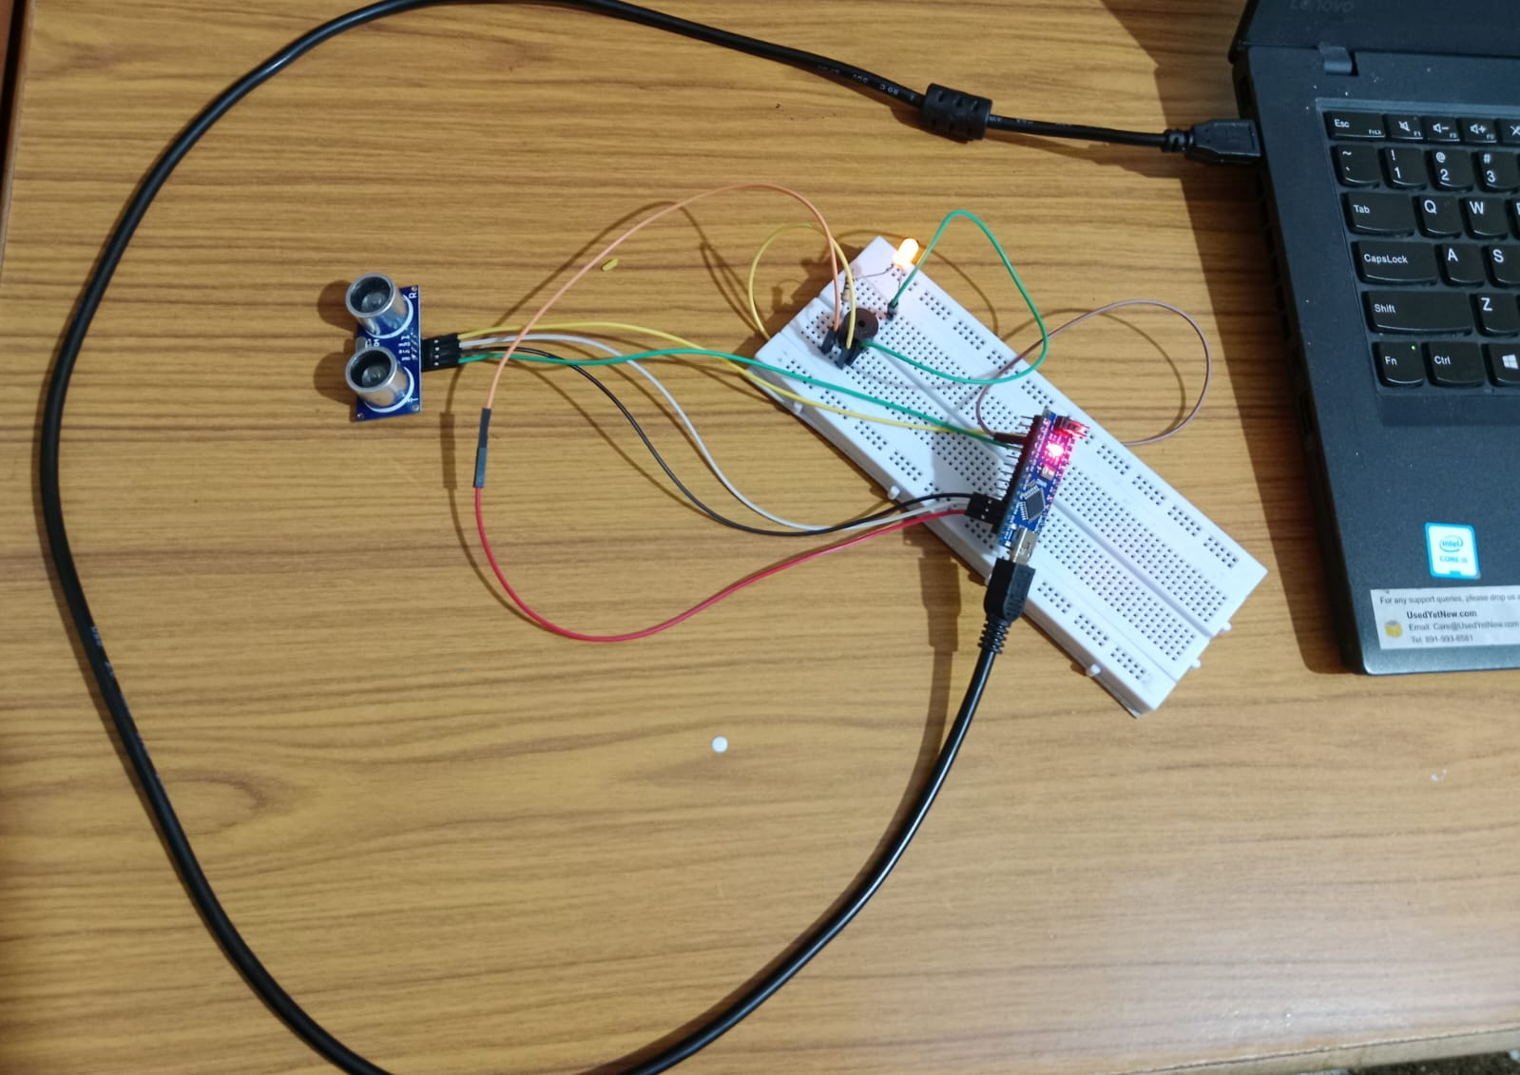
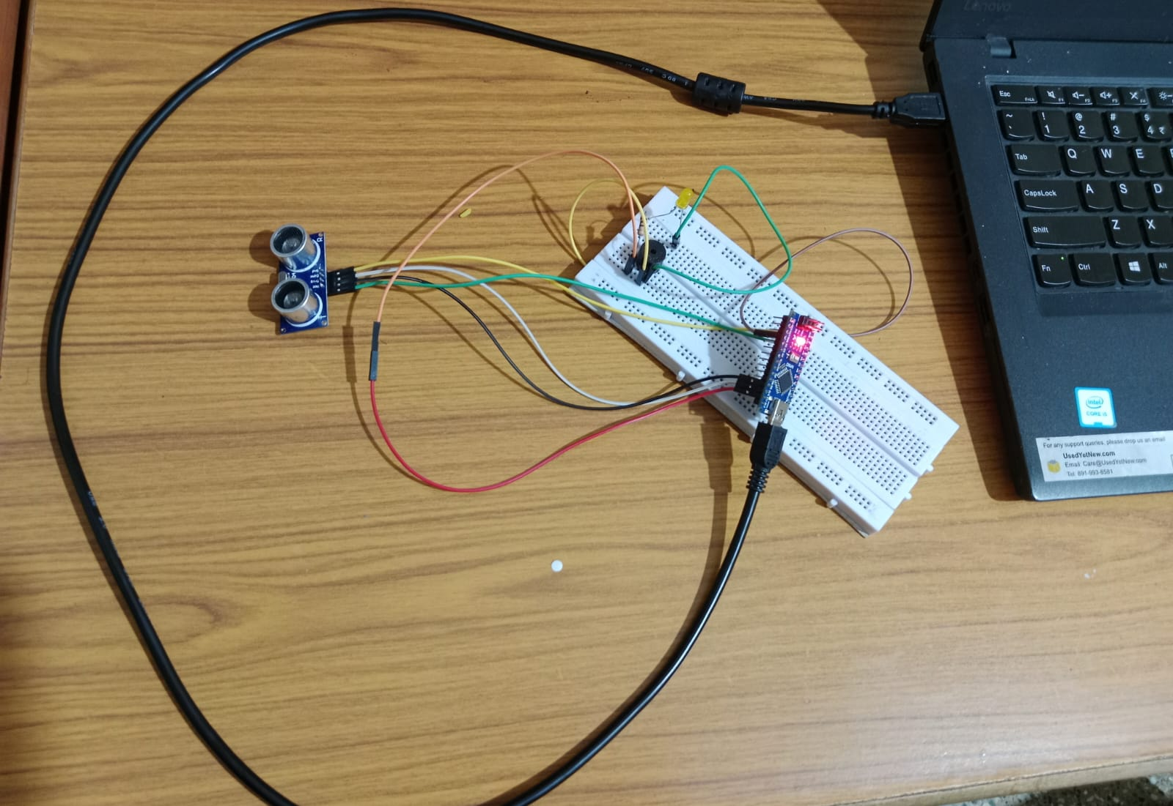
Buzzer is ON
LED Displayed
Buzzer is OFF
LED not Displayed

Slide 21
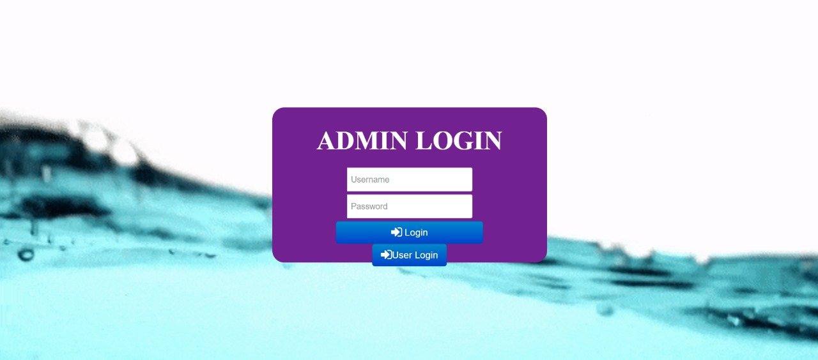
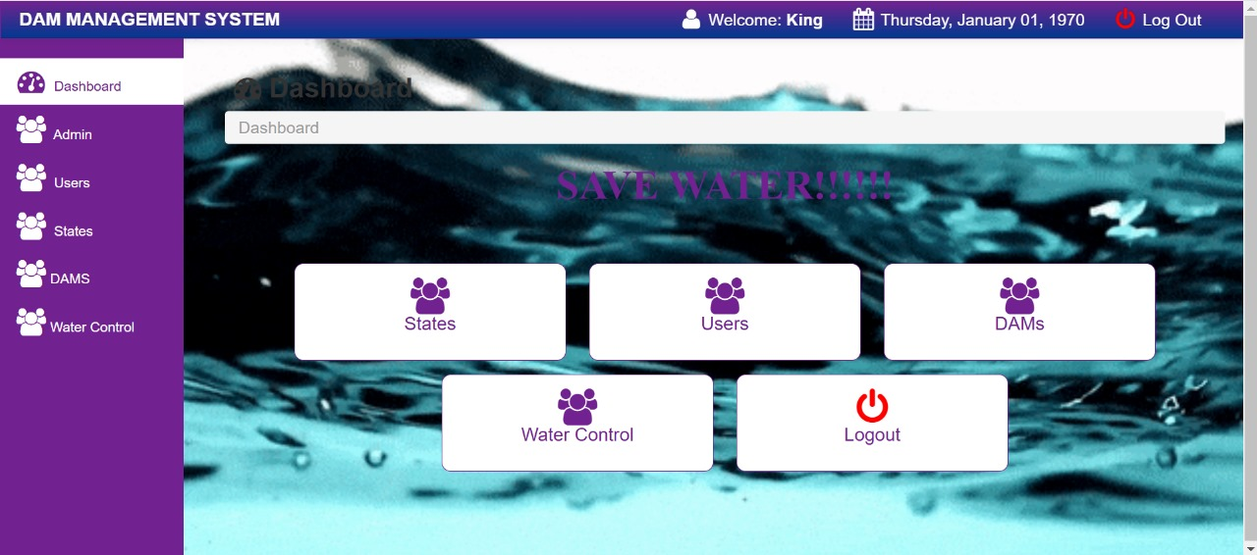
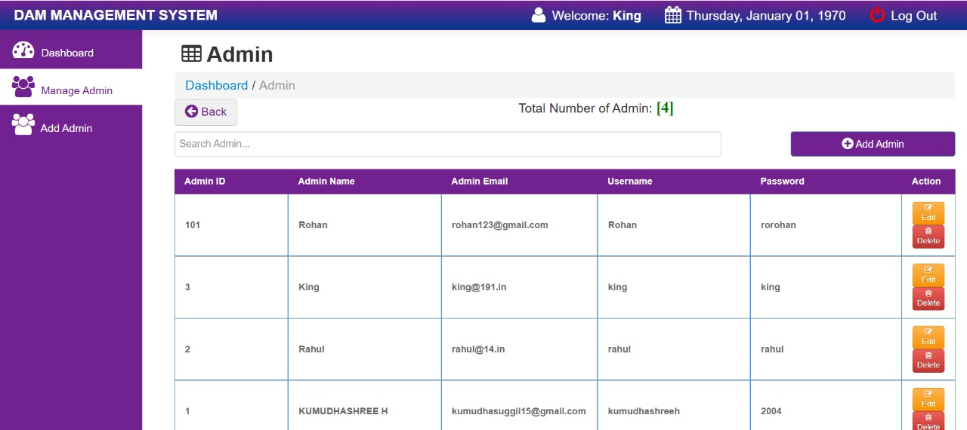
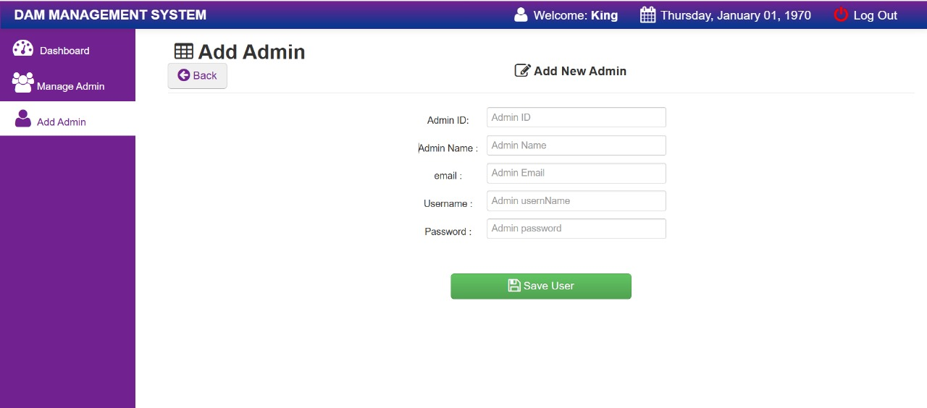

Slide 22
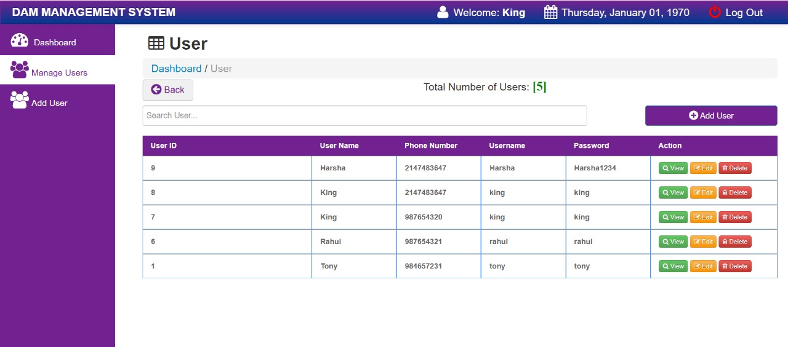
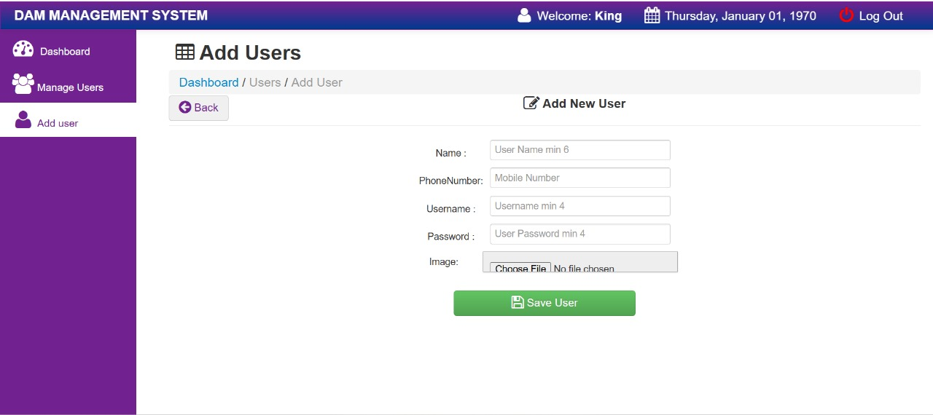
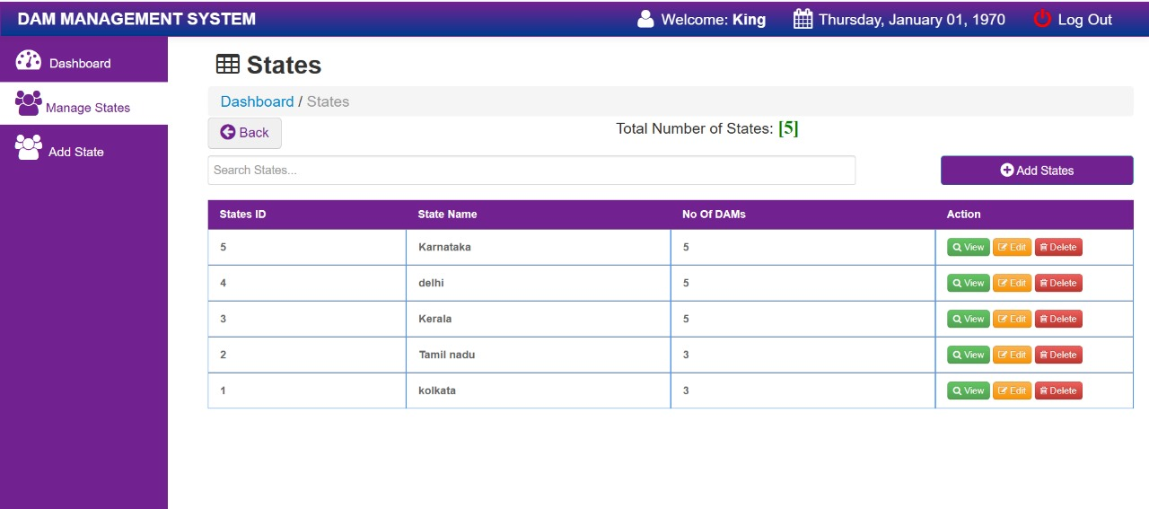
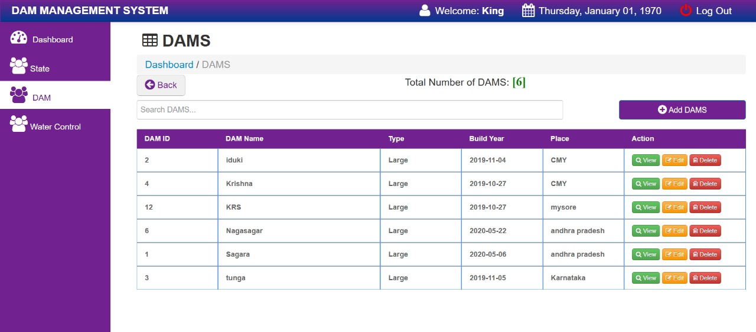

Slide 23
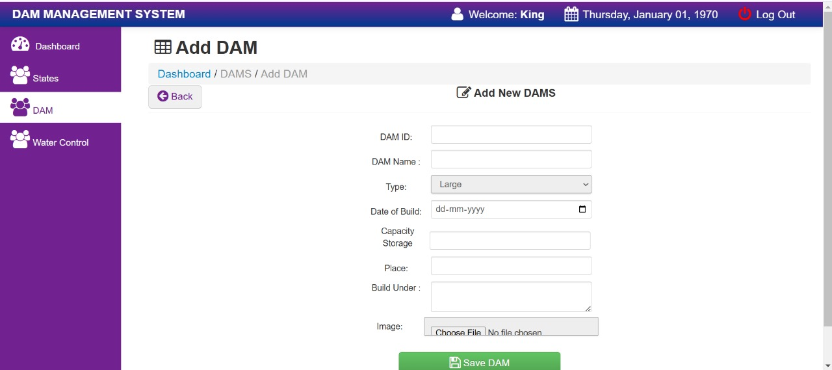
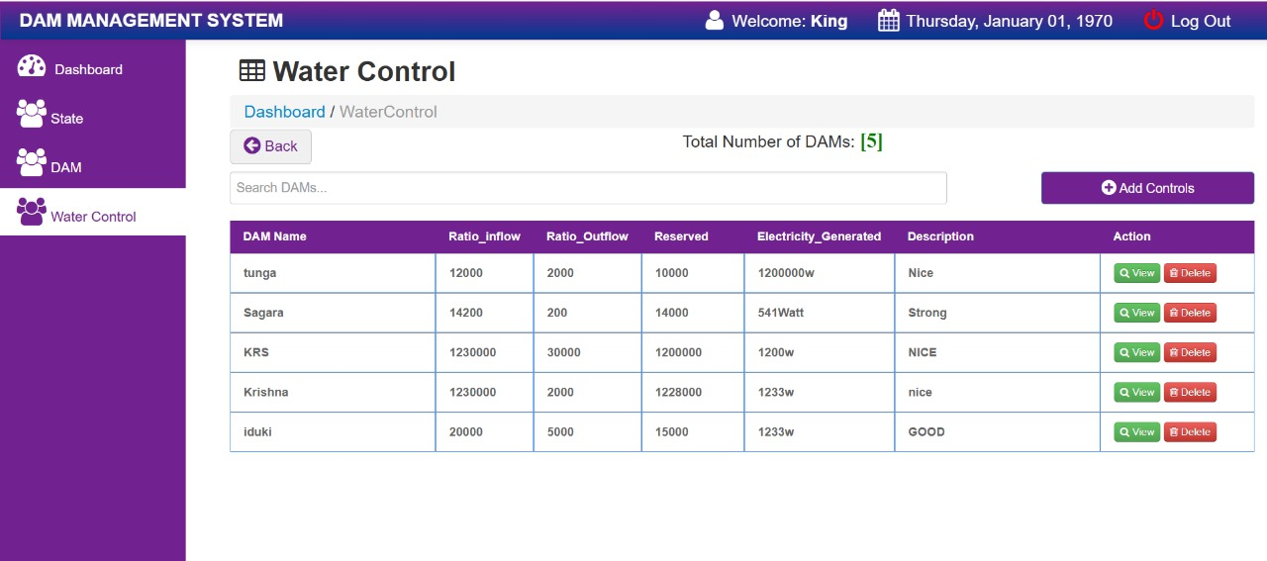
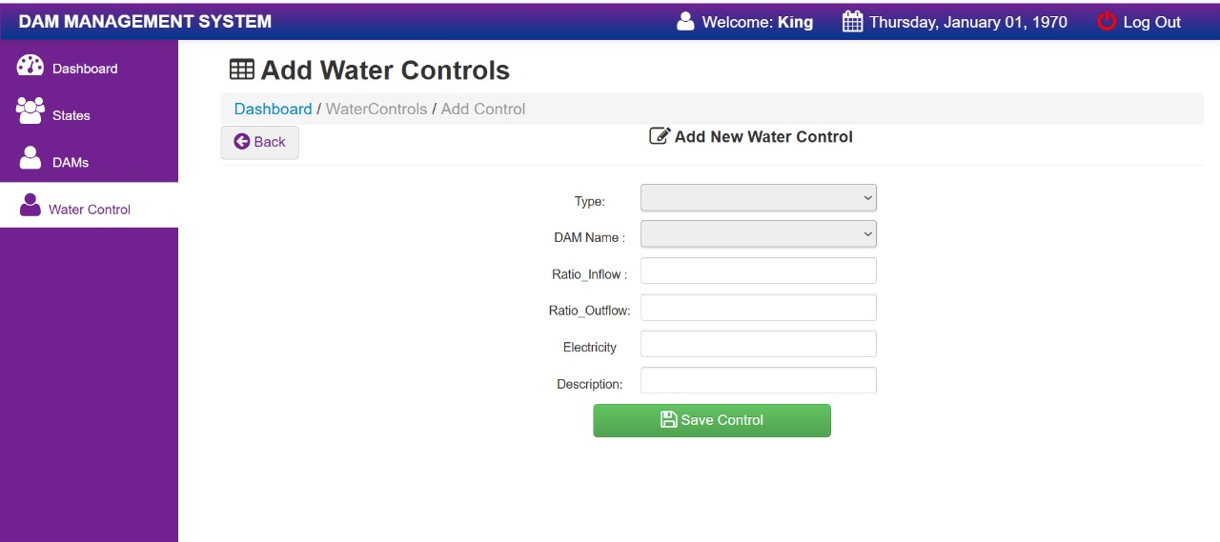

Slide 24
Conclusion

Slide 25
This project successfully monitors water levels in dams and provides early warnings to prevent overflow. The system effectively uses sound alerts and a yellow light to indicate critical water levels. The addition of a website allows for easy tracking and management of data. Overall, the project enhances safety, reduces the need for manual checks, and provides a reliable solution for monitoring water levels in dams.

Slide 26
References
[1]Sai sreekar siddula , Phaneendra babu P.c jain,"Water level monitoring and management of dams",IEEE,2024
[2] 1Anitha Gopalan, 2M. Saranya Nair, 3T Hema Latha, "A Sensitive Design of Dam Water Level Monitoring and Emergency Alert Handling System using Internet of Things",2024 Ninth International Conference on Science Technology Engineering and Mathematics (ICONSTEM) ,2024
[3] Phaneendra babu, 1P.c jain,Sanober,Shama bano,"Smart water level monitoring system using internet of things (iot)",Global conference on wireless and optical technologies (GCWOT)And IEEE,2023
[4] R senthil ganesh ,"An IoT-based Dam Water Level Monitoring and Alerting System",Proceedings of the International Conference on Applied Artificial Intelligence and Computing (ICAAIC 2022)IEEE Xplore Part Number: CFP22BC3-ART,2023
[5] D. Dhinakaran1 , S. M. Udhaya Sankar2 ,B. Charu Latha3 , A. Erlin Joy Anns4 , V. Keerthana Sri5, "Dam Management and Disaster Monitoring System using IoT ",2023 International Conference on Sustainable Computing and Data Communication Systems (ICSCDS) ,2023

Slide 27
Citation
https://ieeexplore-ieee-org-vtuconsortia.knimbus.com/document/8519843
https://ieeexplore-ieee-org-vtuconsortia.knimbus.com/document/10568670
https://ieeexplore-ieee-org-vtuconsortia.knimbus.com/document/10064661/
https://ieeexplore-ieee-org-vtuconsortia.knimbus.com/document/9792675/
https://ieeexplore-ieee-org-vtuconsortia.knimbus.com/document/10105132

Slide 28
Thank you

